Slide 1


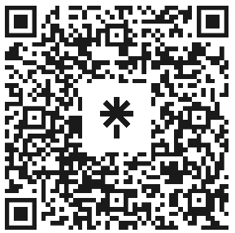

Welcome to Code Crunch!
C8|Crunch Labs: Web Dev
THU 3-4PM Weekly | Spring 2025
Attendance
Earn a Certificate of Completion by attending at least 70% of the workshops
linktr.ee/CODE.CRUNCH

Slide 2
Week #7
Adding Dynamic Visuals and Interactions to Your Website

Slide 3
Introduction to the Week’s Topic
Overview: This week we dive into CSS animations and transitions, as well as advanced DOM manipulation using JavaScript. These techniques allow you to create dynamic, interactive, and engaging user experiences.
Real-World Relevance:
Animations make websites visually engaging, helping to emphasize important elements and improve user experience.
Interactivity through JavaScript lets users interact with the page in real-time, such as by clicking buttons, toggling elements, or showing dynamic content.

Slide 4
Key Concepts for Today’s Lecture
Concepts Covered:
CSS Animations: Keyframes, transitions, and timing functions.
Advanced DOM Manipulation: Creating interactivity with JavaScript.
Real-World Applications: Adding animations to buttons, menus, and interactive elements.

Slide 5
Introduction to CSS Animations
What is a CSS Animation?
CSS Animations allow you to create complex visual effects by animating elements directly in the browser without using JavaScript.
Use Cases: Hover effects, page load transitions, and animated icons.

Slide 6
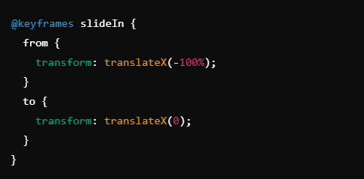
Keyframes: Define the states of the animation.

Slide 7

Applying Animations:

Slide 8
CSS Transitions
What is a CSS Transition?
Transitions enable you to change an element’s style smoothly over a set period when a change occurs (e.g., hovering over a button).

Slide 9
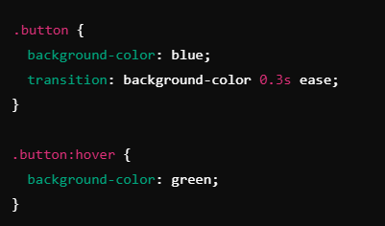

Slide 10
Transition Properties
transition-property: Specifies which property will be transitioned.
transition-duration: Specifies the duration of the transition.
transition-timing-function: Controls the speed of the transition.

Slide 11
Key Differences Between Animations and Transitions
CSS Transitions: Only occur when an element's state changes (e.g., hover, focus).
CSS Animations: Can run automatically, can loop, and can be complex with multiple keyframes.
When to Use:
Use Transitions: For simple, interactive effects like hover or focus changes.
Use Animations: For more complex or continuous animations like sliding, fading, or rotating.

Slide 12
Advanced DOM Manipulation with JavaScript
What is the DOM?
The Document Object Model (DOM) represents the structure of an HTML document as a tree of nodes (elements, attributes, text, etc.).
JavaScript’s Role in DOM Manipulation:
JavaScript allows you to select, modify, add, or remove elements from the DOM dynamically.
Common Methods:
document.getElementById(), document.querySelector(), element.addEventListener()

Slide 13

Example: Changing an element's style via JavaScript:

Slide 14

Event Listeners and Interactivity
What is an Event Listener?
Event listeners allow you to respond to user actions, such as clicks, hover, or keypresses.
Adding an Event Listener:

Slide 15
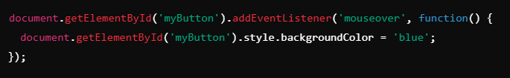
Event Listeners and Interactivity
Handling Mouse Events:
Mouse Events: click, mouseover, mouseout, mousedown, etc.

Slide 16
Real-World Example: Animating a Button

Slide 17
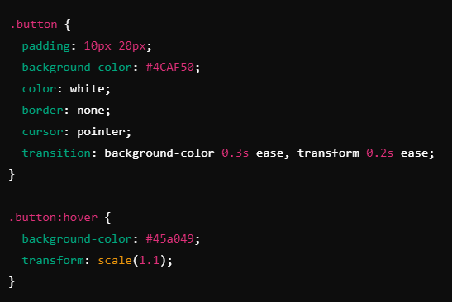
Example: Creating an animated button that changes color and grows when hovered.

Slide 18
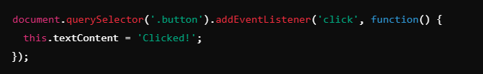
JavaScript Interaction
Use event listeners to add interactive behavior to the button, such as changing the text on click.

Slide 19
Summary of Key Points
CSS Animations: Use for complex, automatic visual effects.
CSS Transitions: Use for interactive, state-change effects.
JavaScript DOM Manipulation: Use for adding interactivity through events and dynamic changes to the page.
Real-World Application: Combining animations and interactivity for engaging user experiences.

Slide 20
Coding Lab

Slide 21
Introduction to the Coding Lab
Objective: In this lab, we will add animations and interactive elements to a webpage. You will use CSS for animations and transitions and JavaScript for event handling and dynamic changes to the DOM.
Skills Covered:
Animating elements with CSS.
Creating interactive buttons and links with JavaScript.

Slide 22
Setting Up the Development Environment
Step 1: Open a new project folder and create an index.html, style.css, and script.js file.
Step 2: Link the CSS and JS files in the HTML document.

Slide 23
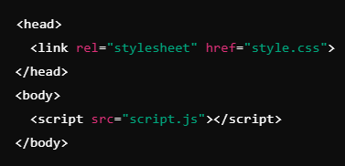

Slide 24
Task 1 - Adding a CSS Transition to a Button
Objective: Add a transition effect to a button element.
Step-by-Step Guide:
Create a button in HTML.
Use CSS to add a transition effect on hover (change color smoothly).

Slide 25

Create a button in HTML.

Slide 26
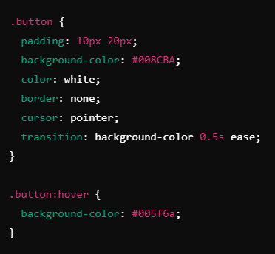
Use CSS to add a transition effect on hover (change color smoothly).

Slide 27
Task 2 - Adding a CSS Animation to a Box
Objective: Animate a box to move from left to right when the page loads.
Step-by-Step Guide:
Create a div with a class of box.
Add a keyframe animation to move the box from left to right.

Slide 28

Create a div with a class of box.

Slide 29
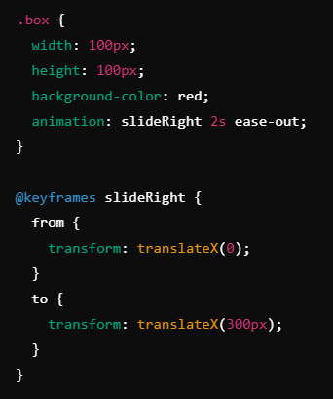
Add a keyframe animation to move the box from left to right.

Slide 30
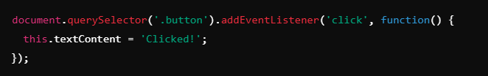
Task 3 - Adding JavaScript Interactivity
Objective: Use JavaScript to change the button’s text when clicked.
Step-by-Step Guide:
Add an event listener to the button that changes its text when clicked.

Slide 31
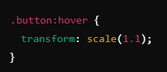
Task 4 - Adding Animation on Button Hover
Objective: Apply a hover effect to scale the button on hover.
Step-by-Step Guide:
Add a transform property to the button’s hover state to scale it.

Slide 32
Debugging and Troubleshooting
Common Issues:
Transitions not working: Ensure that properties are animatable.
Animation not playing: Check that @keyframes is defined correctly.
JavaScript event listeners not firing: Ensure correct element selection.

Slide 33
Q & A Session

Slide 34

https://github.com/CODE-CRUNCH-CLUB/C8-CRUNCH-LABS-WEB-DEV

Slide 35





Attendance
Join us for the next sessions
Check our schedule on Discord “Schedule” Channel
RSVP lu.ma/CODECRUNCH
Your feedback helps us improve. Share your thoughts! Go to our website: go.fiu.edu/codecrunch
linktr.ee/CODE.CRUNCH

